Slide 1
TEAM PRESENTATION
CIS 4560 Lending Club Loan Data
Riki Chang, Carolina Rivera, David Sayad, Chris Wallace

Slide 2
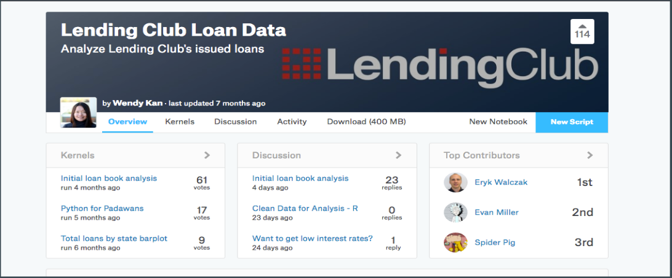
The Data
https://www.kaggle.com/wendykan/lending-club-loan-data

Slide 3
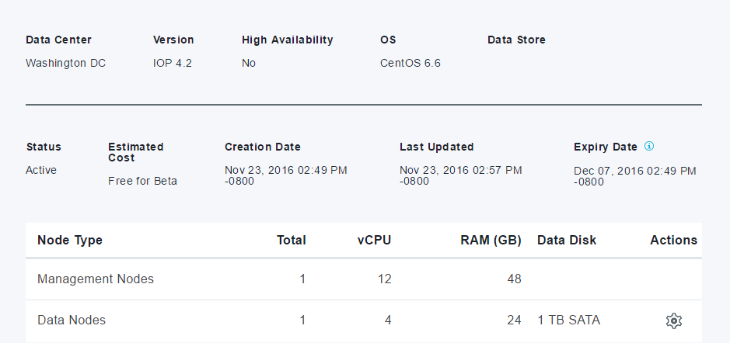
Node Information

Slide 4
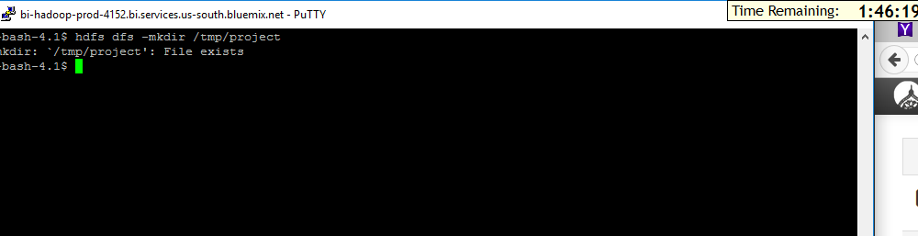
You have to upload the files to hdfs folder
Run the following HDFS commands to create folder

Slide 5
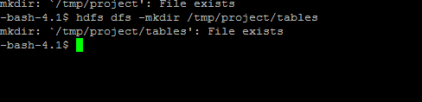
Store tables in HDFS

Slide 6
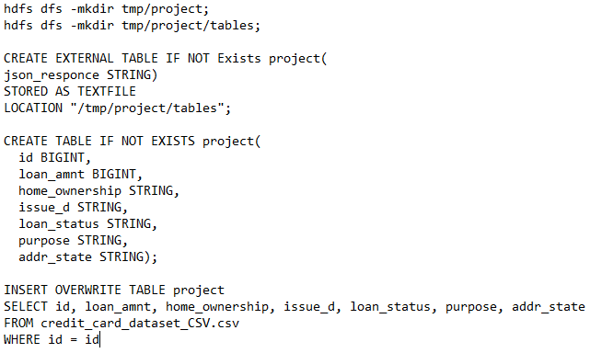
Created two tables in HIVE

Slide 7
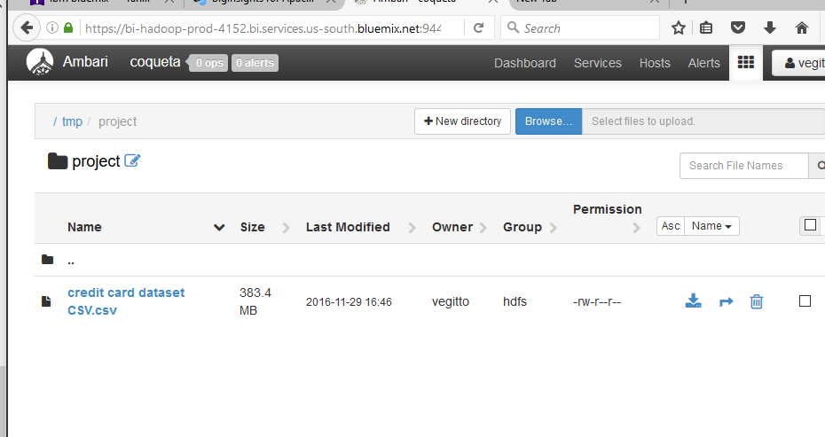
We uploaded our dataset into Ambari

Slide 8
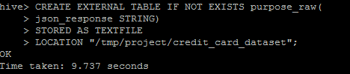
We created a table to store the raw data we just uploaded to Ambari

Slide 9
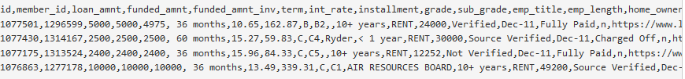
We executed the SELECT statement and uploaded into Purpose table, then we downloaded a table from Amabari

Slide 10
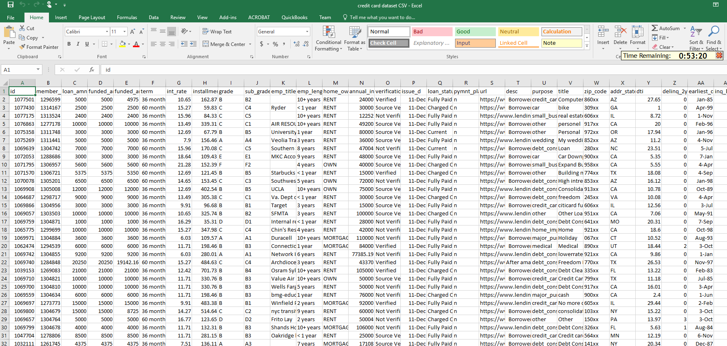
887379 entries in dataset

Slide 11
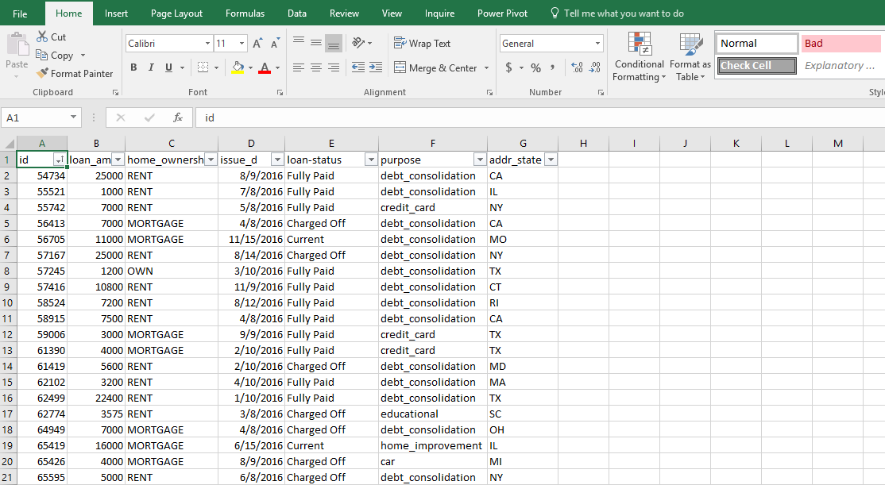
New table

Slide 12
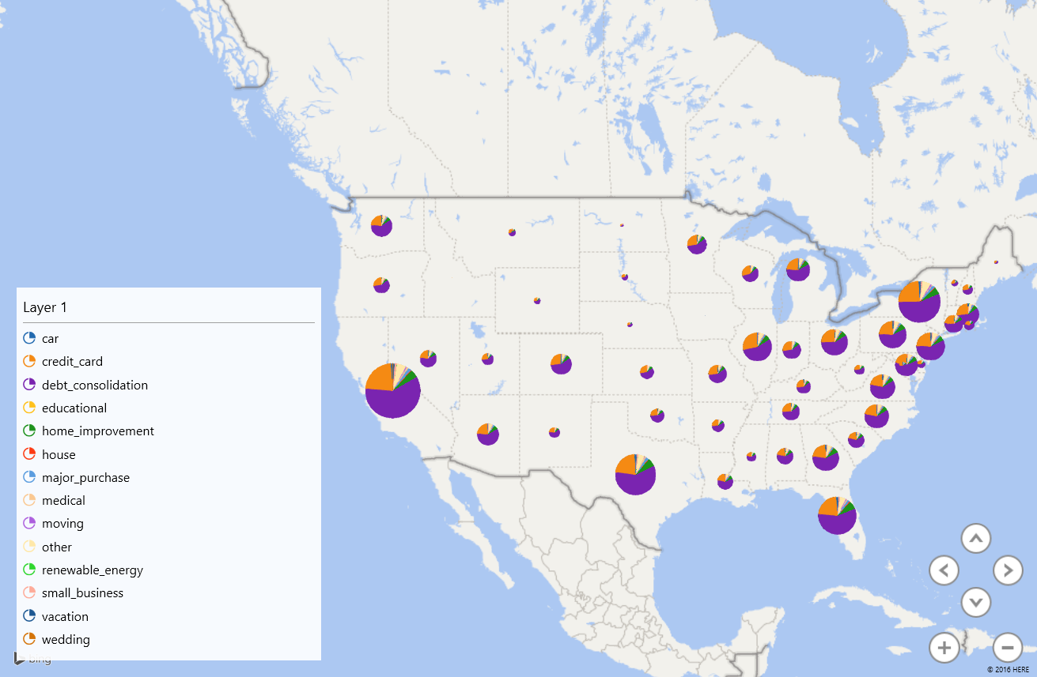
3D VISUALIZATION - Purpose

Slide 13
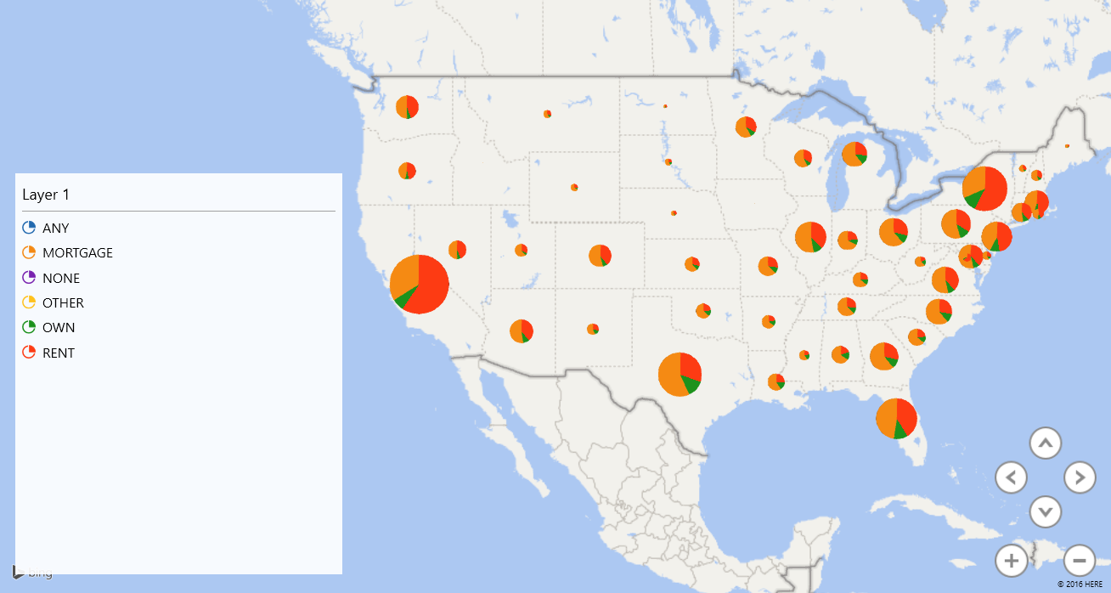
3D VISUALIZATION - Home Ownership

Slide 14
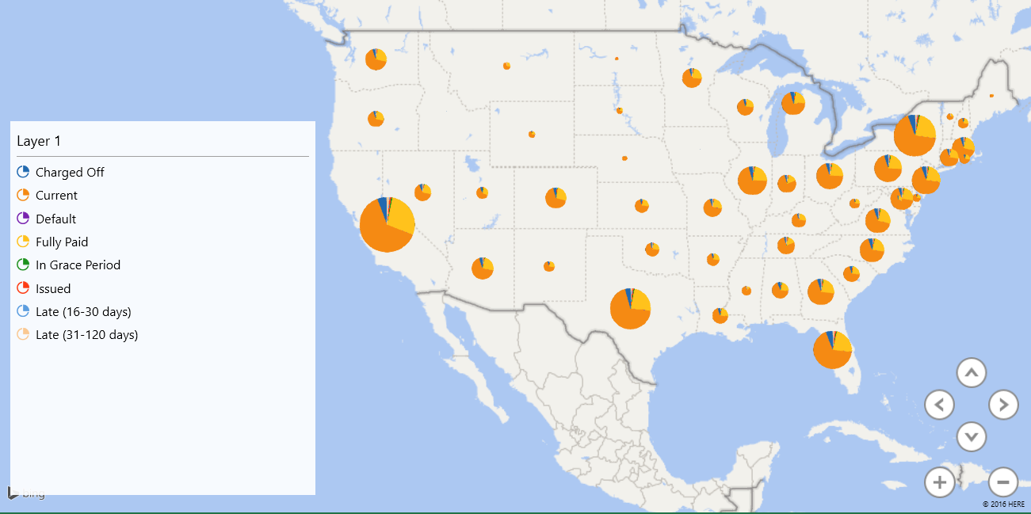
3D VISUALIZATION - Loan Status

Slide 15
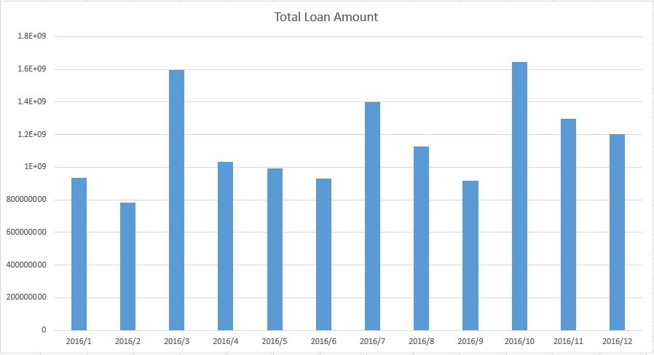
3D VISUALIZATION – Month Issued and Total Loans

Slide 16
References
Questions
Data set was downloaded from here website in CSV format
https://www.kaggle.com/wendykan/lending-club-loan-data

